Slide 1
Project Proposal
CSE718
Md Sabbir Hossain Nishat Nayla
Tamanna Tasnim

Slide 2

Employing Computational Simulation to Elucidate and Therapeutically Address Mental Health Pathologies: A Multifaceted Methodological Approach for Enhanced Understanding and Intervention

Slide 3
Problems to solve
Mental health disorders in the tech industry significantly affect productivity and employee well-being, posing a substantial challenge that traditional intervention methods struggle to address effectively.
The complexity of mental health issues and the intricate combination of contributing factors necessitate a more sophisticated approach for understanding and intervention.
1
3
2
A computational simulation method as a novel approach to analyze mental health data within the tech sector.
4
The goal is to derive detailed insights through computational analysis to guide the development of impactful therapeutic strategies.

Slide 4
Project objective
The primary objective of this project is to develop and apply sophisticated computational models to a dataset of mental health surveys from the tech industry. The goal is to identify patterns, predict outcomes, and ultimately propose data-driven interventions that can be implemented in the tech workplace.

Slide 5
Background:

Slide 6

Mental Health
The high-pressure environment of the tech industry has been associated with increased stress and mental health issues. However, there is a lack of comprehensive studies that use computational methods to analyze mental health in this sector. By employing advanced simulation techniques, this project seeks to bridge this gap and contribute to the field of mental health research.

Slide 7
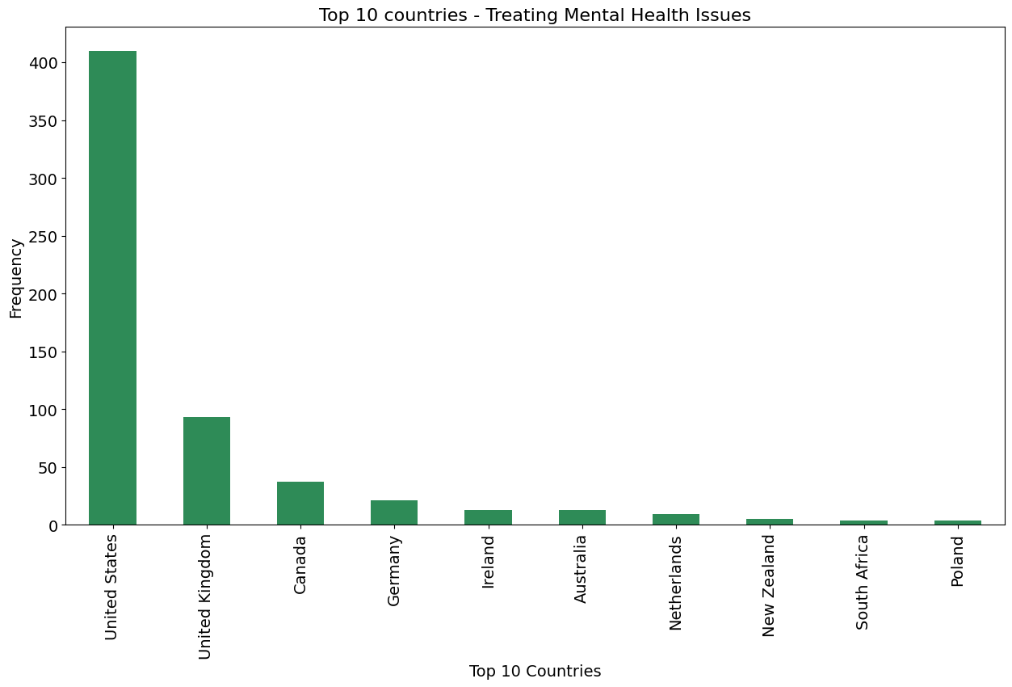
Dataset
Mental Health in Tech Survey
1259 entries
27 columns

Slide 8
Methodology:
Data Preprocessing: Cleaning the data and preparing it for analysis, including handling missing values and encoding categorical variables.
Exploratory Data Analysis (EDA): Conducting EDA to understand the distribution of data and preliminary patterns.
Feature Correlation Analysis: Assessing the relationships between different variables to identify potential predictors of mental health outcomes.
Model Development: Training and fine-tuning multiple machine learning models, including KNN, Random Forest, SVM, and Decision Trees.
Model Evaluation: Comparing models based on accuracy, precision, recall, and F1 score to select the best-performing ones.
Result Interpretation: Drawing conclusions from the model outcomes to propose actionable interventions.

Slide 9
Expected Outcomes:
The project is expected to yield a set of predictive models that can accurately forecast mental health outcomes based on survey data. These models will highlight key factors contributing to mental health issues in the tech industry, providing a basis for targeted interventions.

Slide 10
Conclusion
Through computational simulation and analysis, this project stands to make a valuable contribution to mental health research within the tech industry. By translating complex data into actionable insights, we can pave the way for a healthier and more productive workforce.

Slide 11
Thank you.

